Slide 1




GreenForesight.AI
Rugwed Yawalkar :- 22070521010
Ameen Khan :- 22070521007
Arya Dashputra :- 22070521022
Pawan Hete :- 22070521095
Himanshu Sayankar :- 22070521025

Slide 2

Learning Objectives
The objective of the GreenForesight.AI project was to design an interactive platform that combines artificial intelligence with environmental modeling to simulate and communicate the impact of lifestyle choices on sustainability.
Key learning goals included:
Building a modular web app using Streamlit with effective state management.
Modeling carbon emissions through rule-based logic based on real-world data.
Integrating generative AI for storytelling (Cohere) and image generation (Hugging Face Diffusers).
Visualizing data through charts and exporting a complete PDF report using WeasyPrint.
Bridging technology and sustainability by creating a tool that raises environmental awareness through engaging narratives and visuals.

Slide 3
Problem Statement:
Modern climate awareness campaigns often lack:
Personal relevance — users don’t see how daily actions affect the planet.
Real-time, customized feedback on their environmental impact.
Engaging, emotional narratives that drive behavior change.
Challenges:
Carbon footprint calculators are either too generic or too technical.
No direct storytelling connection between lifestyle and climate future.
Visual imagination of sustainable futures is often missing.

Slide 4
Solution:
Introducing GreenForesight.AI — an AI-powered web platform that:
Simulates your carbon footprint based on daily habits (diet, transport, plastic use, energy).
Visualizes projected “green score” over time with line charts.
Breaks down emissions by category using bar graphs.
Uses Cohere/OpenAI to generate personalized climate-impact stories.
Creates AI-generated images of future cities with Stable Diffusion.
Exports the full narrative and visuals as a downloadable PDF.

Slide 5



Tools and Technology used
Frontend & UI
Streamlit – For building the interactive web interface
HTML/CSS – Custom styling for PDF layout and app aesthetics
WeasyPrint – Convert HTML content into styled, downloadable PDFs
🧠 AI & Generative Models
Cohere API – AI-generated storytelling based on user simulation data
Hugging Face Diffusers – Stable Diffusion for visualizing future environments from prompts
📊 Data & Visualization
Matplotlib – To generate line and bar charts for simulation outputs
Base64 Encoding – For embedding visual outputs into PDF
🧮 Backend & Simulation
Python – Core logic, file handling, and modular architecture
Pandas – Emissions data processing and projections
CSV Dataset – Emission values by lifestyle activity from emission_table.csv

Slide 6
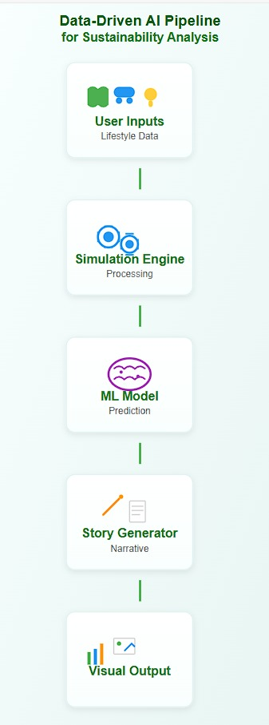
Methodology
User Input Interface Users submit lifestyle choices (diet, commute, plastic, energy) via a Streamlit-based form.
Emission Simulation A backend engine maps choices to CO₂ values using a CSV dataset. It calculates total emissions, a Green Score, and projections for future years (2035–2075).
AI Story Generator (Cohere) Using the simulation output, the Cohere API generates a personalized narrative about the user's environmental future.
AI Image Generator (HuggingFace Diffusers) Based on user input, a prompt is created to generate a futuristic image of their world using Stable Diffusion.
Visualization with Charts The system plots:
A line chart for Green Score over time
A bar chart of CO₂ emission by activity
6) PDF Report Generation The story, image, charts, and impact summary are compiled into a professionally styled PDF using WeasyPrint.
7) State Management Streamlit’s session state retains data across steps for smooth user experience and consistent output generation.

Slide 7
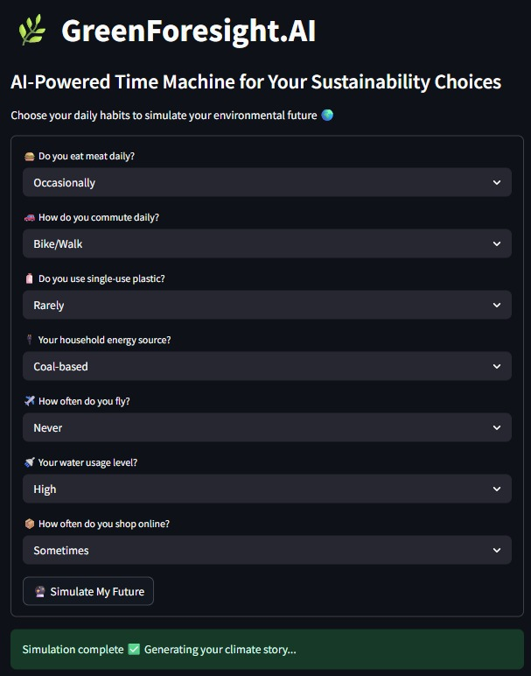
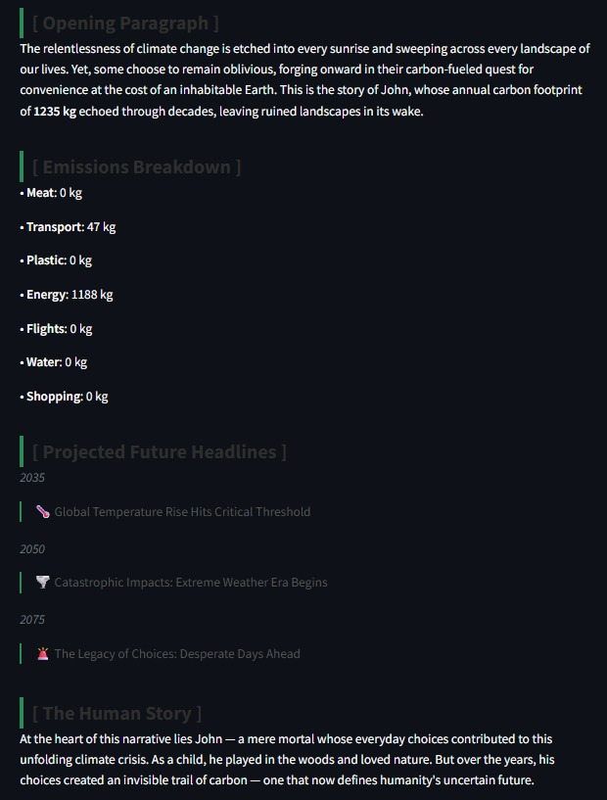
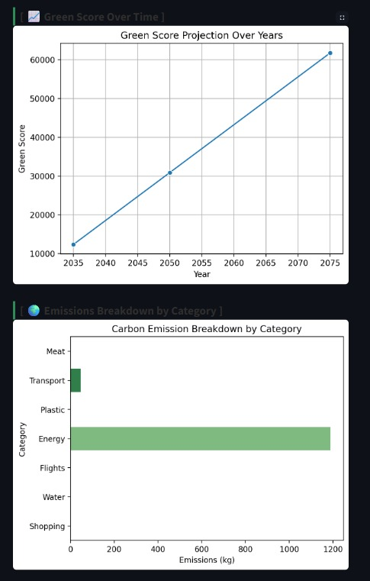

Screenshot of Output:

Slide 8

Conclusion:
GreenForesight.AI transforms sustainability awareness into personal storytelling:
Bridges the gap between data and emotion through narrative.
Encourages individual accountability for climate action.
Offers a future-ready tool for education, CSR, and behavioral change campaigns.
GitHub Link

